Slide 1
Discussion 9: Heaps of Hashing
Christine Zhou

Slide 2
Agenda
Announcements
Heaps
Problem 1
Hash tables
Problem 2
Hash Codes
Problem 3

Slide 3
Announcements
Mid-semester survey due this Wednesday
A little too much group work (How useful is groupwork? 3.454545455)
Goes a little too slowly
Midterm coming up next week
Start studying early!
Alternate info will come out today
Project 2
Take a look at spec for extra credit opportunities!
Start early! We’ll have a project party as well
Attendance: tinyurl.com/cz-disc9-fa18

Slide 4
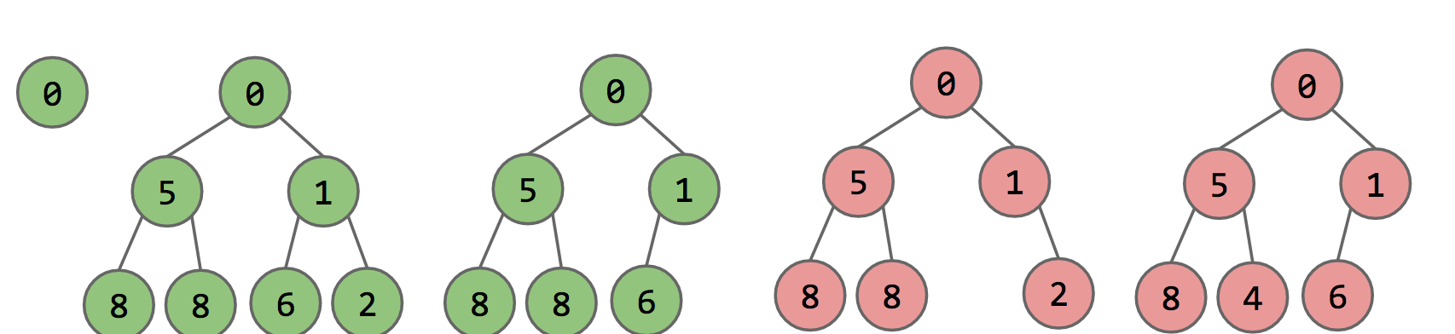
Heaps
Sometimes we want to organize elements in a certain way, always get the minimum
Use a heap!
Complete: missing items only at the bottom level and pushed as far left on the bottom level as possible
(Min/Max) heap property: every node’s value is (less/greater) than or equal to its children’s value

Slide 5
Common Methods of Heaps
Insert
Put new item in first free bottom leftmost position, then bubble up
removeMin/removeMax
Replace root item with the bottom rightmost item, then bubble down the root
getMin/getMax
Return the value at the root

Slide 6
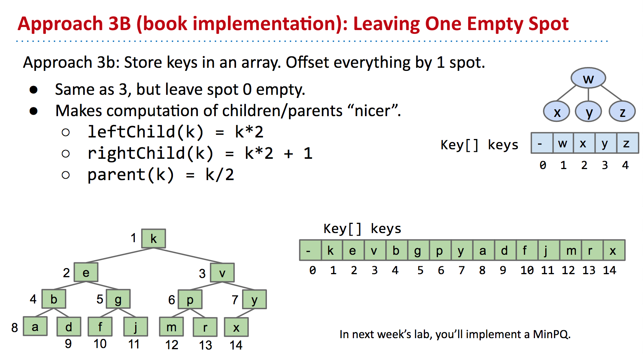
How do we represent heaps?

Slide 7
Heaps vs PriorityQueues
The priority queue is an abstract data type that contains the following methods:
insert(item, priority): Inserts item into the priority queue with priority value priority.
Poll: Removes and returns the highest priority item in the priority queue.
Peek: Returns the highest priority item.
There are many ways to implement this
LinkedList?
Set?
HashMap?
Binary min heap!

Slide 8
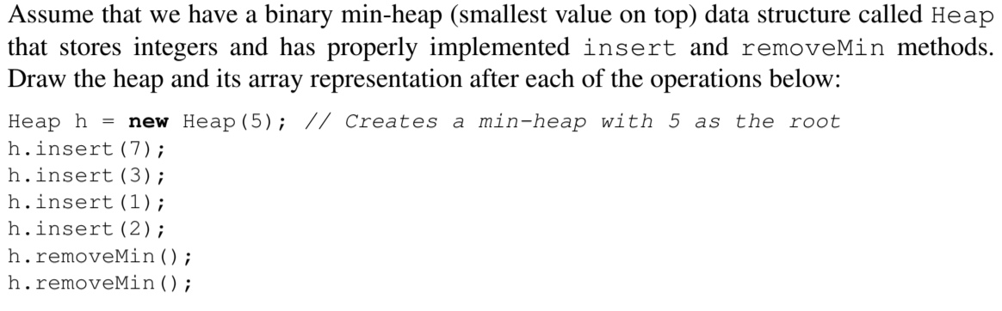
1 Heaps of fun

Slide 9
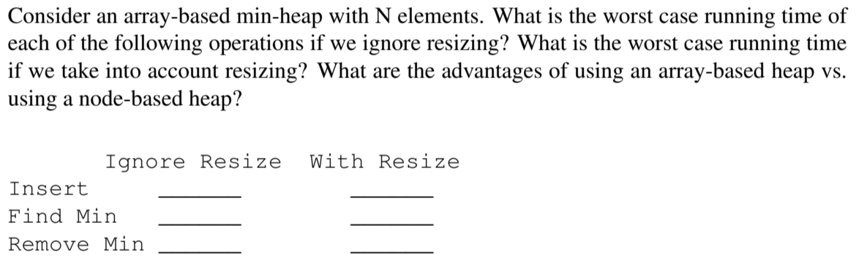
1 Heaps of fun

Slide 10
HashMaps
Use an array to represent your data
For each key-value pair, assign each key a “hash code”
mod (%) the hash code by the length of the array (this gives you a number between 0 and array.length - 1), use this as the index!
Be careful about negative numbers when modding!
N = num elements, M = num buckets, C = some constant
If N/M > C, then increase M!
N/M is called the load factor
If we have multiple elements that go to same place in the array, usually we will keep track of a list
This is called external chaining
What is the runtime of .contains and .insert?

Slide 11
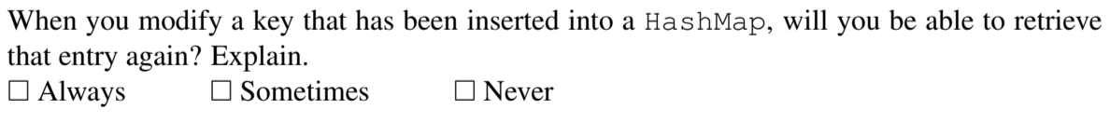
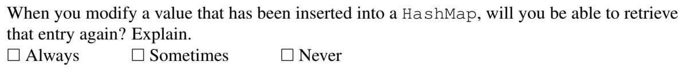
2 HashMap Modification

Slide 12
Hash Codes
What is necessary for a valid hash code?
If A.equals(B) is true, then A.hashCode() == B.hashCode()
The opposite is not necessarily true
What is necessary for a good hash code?
Spread things out nicely/evenly in our hash table
Default: use Object class’s hashCode method
Returns the address of the object
We can override this method

Slide 13
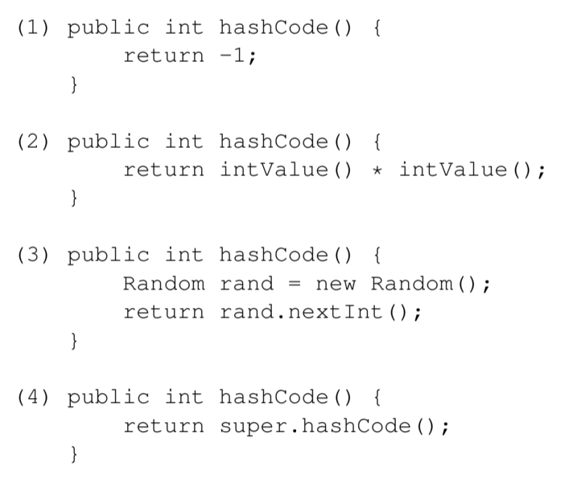
3 Hash Functions
Here are three potential implementations of the Integer’s hashCode() function. Categorize each as either a valid or an invalid hash function. If it is invalid, explain why. If it is valid, point out a flaw/disadvantage.
Note: A “valid” hashCode() means that any two Integers that are .equals() to each other should also return the same hash code value.
Another note: the Integer class extends the Number class, a direct subclass of Object. The Number class’ hashCode() method directly calls the Object class’ hashCode() method.

Slide 14
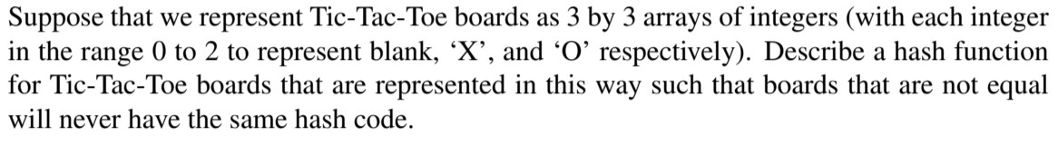
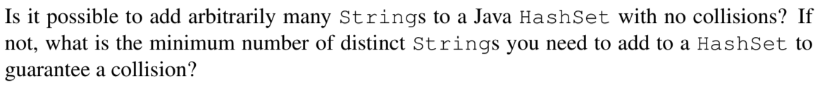
3 Hash Functions

